Slide 1
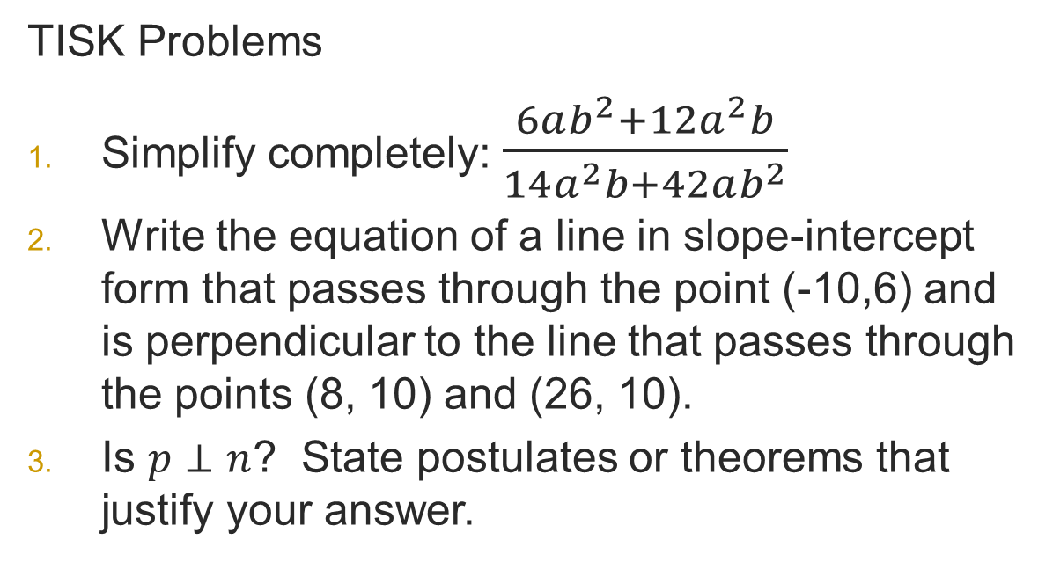
Thursday, February 14, 2013 Agenda
TISK & No MM
Lesson 9-7 Special Segments in a Circle
Homework: 9-7 problems in packet 2
TISK Problems
Simplify completely: $\frac{6ab^{2}+12a^{2}b}{14a^{2}b+42ab^{2}}$
Write the equation of a line in slope-intercept form that passes through the point (-10,6) and is perpendicular to the line that passes through the points (8, 10) and (26, 10).
Is $p⊥n$? State postulates or theorems that justify your answer.
p
r
8
5
7
6
n
2
1
10
3
4
9
11
12
m

Slide 2
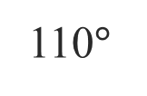
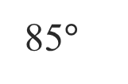
Chapter 9 Quiz 1
9A
9B
Class Average: 74.8%
Class Median: 75.4%
High: 99.3%
Low: 48.6%
Class Average: 79.6%
Class Median: 79.3%
High: 98.6%
Low: 50%
110$°$
5 in.
Two most-missed problems.
85$°$

Slide 3
Theorem
For any 2 chords that intersect in a circle, the product of the parts of the first chord is equal to the product of the parts of the second chord.
C
B
E
D
A

Slide 4
Example 1: Find the value of x.
D
B
x
9
16
12
C
A

Slide 5
Definitions
R
PR is a secant segment
PQ is an external secant segment
Q
PS is a tangent segment
P
S

Slide 6
Theorem
For any 2 secant segments that share an external endpoint, the product of the external secant segments and their corresponding secant segments are equal.
B
E
A
C
D

Slide 7
Theorem
For any secant segment and tangent segment that intersect outside a circle…
A
E
C
D

Slide 8
Example 2
Find the value of x.
F
10
E
11
D
12
G
x
H

Slide 9
Check Point
Find the values of x and y (leave as a mixed number where necessary).
F
20
E
25
y
D
14
C
8
24
G
16
x
H

Slide 10
Example 3
Find the value of x.
B
30
A
x
C
24
D

Slide 11
On your own…
Find the value of x.
E
24
F
12
D
G
x
C

